Slide 1

AI-Powered Meeting Summarizer
Meetings consume 15-20 hours/week for professionals (As per recent industry reports).
67% of employees feel unproductive in meetings (Indian Staffing Federation, 2023).
Our solution automates notes, action items, and insights, boosting efficiency.

Slide 2
The Meeting Maze: Hidden Costs of Inefficiency
Information Loss
Delayed Follow-ups
Manual note-taking leads to 40% loss of critical information.
Post-meeting follow-ups delayed by 24-48 hours due to summary lag.
Productivity Drain
Project Delays
Rs 1.5 crore annual productivity loss for a 500-employee firm due to poor meetings.
Lack of clarity in action items causes 20% project delays.

Slide 3
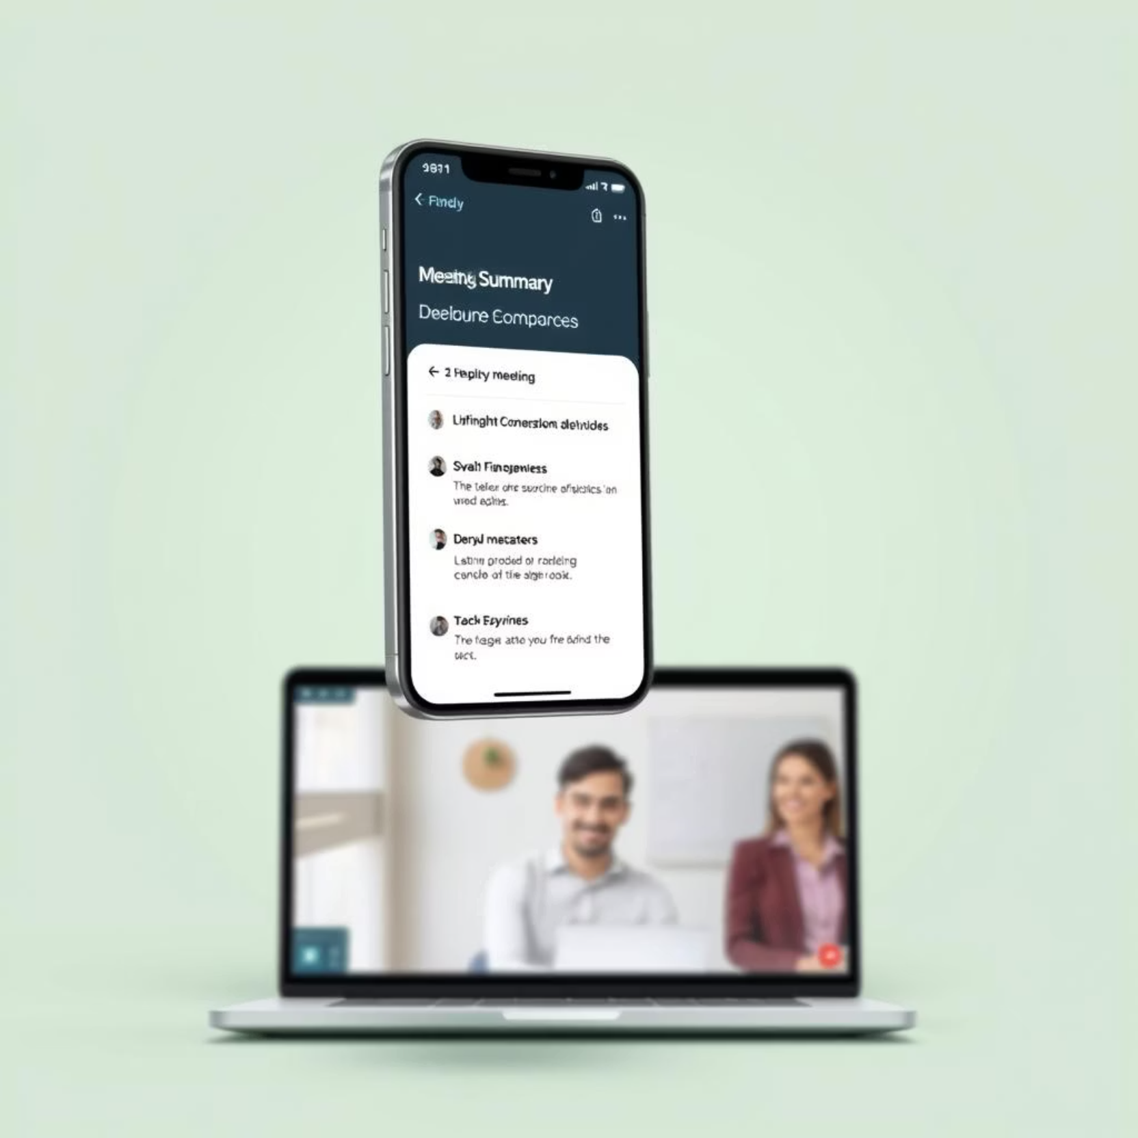
Introducing Your Smart Meeting Assistant
Leverages advanced Natural Language Processing (NLP) for accurate transcription.
Converts large conversations into concise 5-minute actionable.
Provides list of Action Tasks assigned to different members
Mentions deadlines of each of the action tasks assigned.
Allows user to download the the summary of the meeting

Slide 4



Core Features: Intelligence at Your Fingertips
Quick Summarization
Key Takeaway Extraction
Action Item Identification
Summarizes the entire meeting into smaller paragraphs.
Identifies 5-7 crucial decisions and discussion points.
Automatically assigns tasks to specific attendees.

Slide 5

Versatile Applications: Impact Across Sectors
IT Services: Streamline client calls, daily scrums, and project reviews.
Consulting Firms: Capture detailed client requirements and strategic discussions.
Sales Teams: Summarise discovery calls, track leads, and client objections.
Education: Record lectures, summarise student queries and faculty meetings.
Healthcare: Document patient consultations and medical team discussions efficiently.

Slide 6

The Future is Efficient: Empowering Every Conversation
Transform meetings from obligation to actionable insight.
Scale productivity across your organisation.
Join leading Indian companies adopting intelligent automation.
Drive smarter decisions, faster execution.

Slide 7


Future Scope: Expanding Your Productivity Ecosystem
Seamless Platform Integrations
Automated Calendar Sync
Connect with your daily tools: automatically post meeting summaries to Slack channels or create Jira tasks directly from action items, ensuring no follow-up is missed.
Transform insights into action. Our system will intelligently identify key decisions and allow you to instantly schedule follow-up meetings or set reminders in your calendar with just one click.
We are continuously innovating to build a more connected and efficient workflow for Indian businesses, ensuring our AI-powered assistant grows with your evolving needs.

Slide 8


Under the Hood: Our Technology Stack
Frontend Architecture
Robust Backend System
Developed using Builder.io, a powerful low-code platform, combined with React and TypeScript to deliver a dynamic, scalable, and intuitive user interface for seamless interaction.
Engineered with FastAPI in Python for high performance. It integrates Hugging Face Transformers and the Facebook BART CNN library for cutting-edge Natural Language Processing and accurate summarization.

